Slide 1
Bayesian estimation for time series models
Feb 14 2017
Eric Ward

Slide 2
Re-cap following models using Bayesian code
Regression
ARMA models
State Space Models
Dynamic Factor Analysis
Dynamic Linear Models
MARSS models (multivariate time series models)

Slide 3
Why Bayesian?
Complex hierarchical models
Inference: what’s the probability that the data are less than some threshold?
No bootstrapping!
We get credible intervals for parameters and states simultaneously

Slide 4
Getting started
library(rstan)
library(devtools)
devtools::install_github("eric-ward/safs-timeseries/statss")
library(statss)

Slide 5
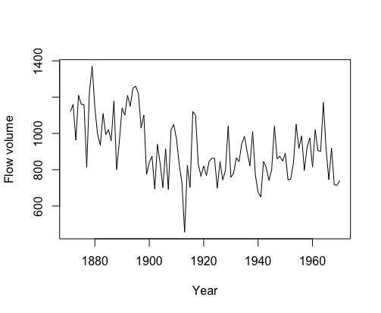
Using STAN objects
Flow volume from Nile River
Notes:
library(datasets) data(Nile) #load the data plot(Nile,ylab="Flow volume",xlab="Year")

Slide 6
Fitting linear regression
We’ll use wrapper function 'fit_stan’
x = model.matrix(lm(Nile~1))
lm_intercept = fit_stan(y = as.numeric(Nile), x = rep(1, length(Nile)), model_name = "regression")

Slide 7
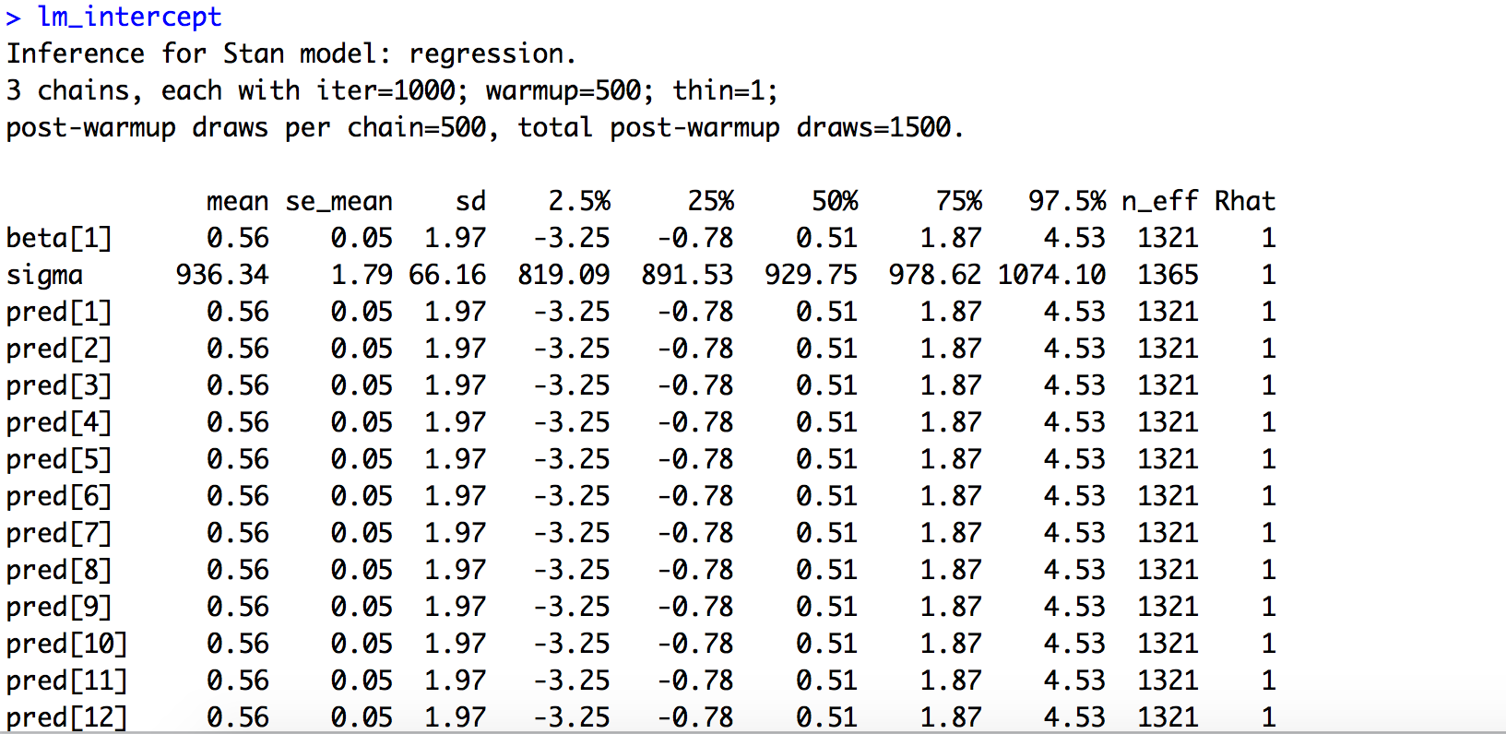
Output of fitted object

Slide 8
Output from model
Can be plotted using base graphics in R
pars = extract(lm_intercept)
hist(pars$beta, 40, col="grey", xlab="Intercept", main="")
quantile(pars$beta, c(0.025,0.5,0.975))

Slide 9
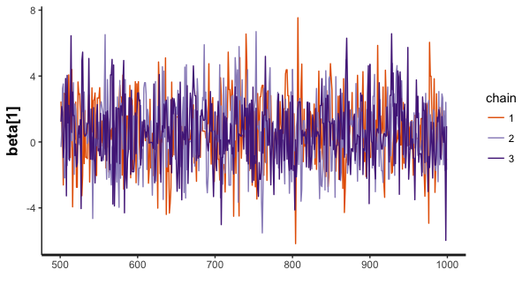
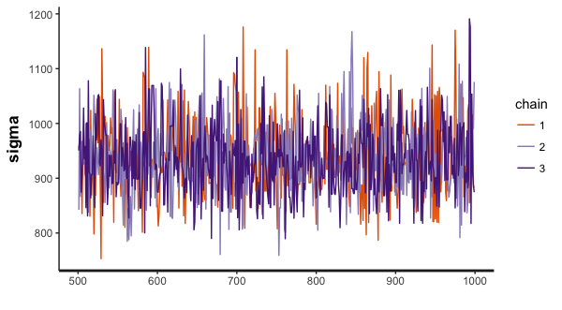
Traceplots of parameters
traceplot(lm_intercept, pars = "beta[1]")
traceplot(lm_intercept, pars = "sigma")

Slide 10
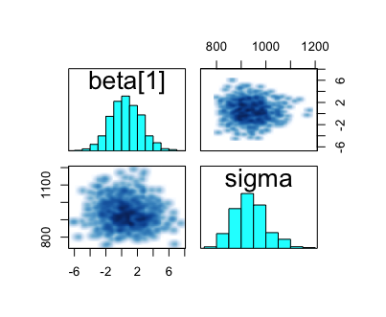
Pairs plots between parameters
pairs(lm_intercept, pars=c("beta[1]","sigma"))

Slide 11
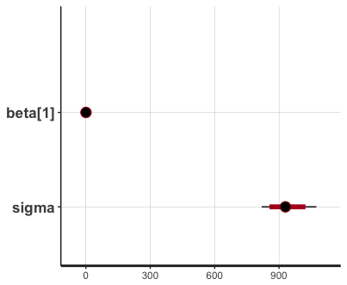
Plots with credible intervals
plot(lm_intercept, pars=c("beta[1]","sigma"))
ci_level: 0.8 (80% intervals)
outer_level: 0.95 (95% intervals)

Slide 12
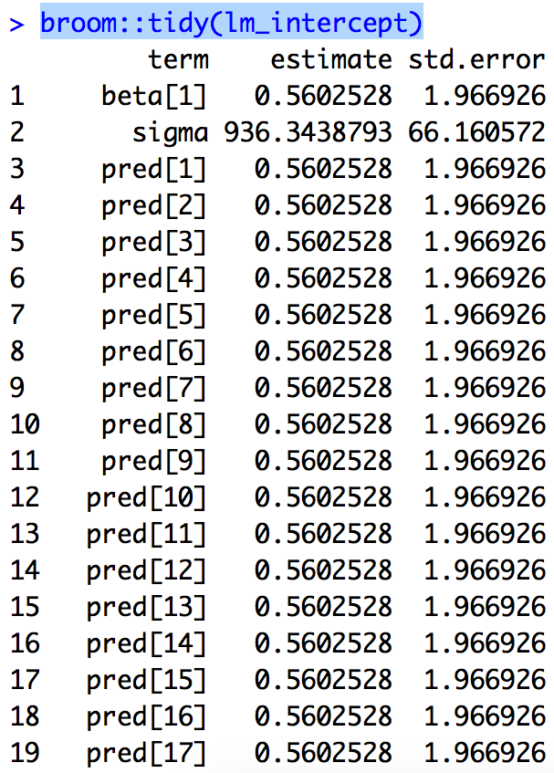
Getting tidy summaries
coef = broom::tidy(lm_intercept)

Slide 13
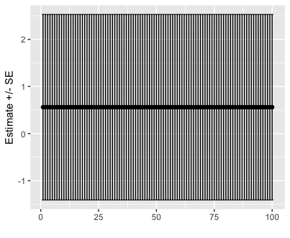
Useful in ggplot, for example
ggplot(coef[grep("pred",coef$term),], aes(x = 1:100,y=estimate)) + geom_point() + ylab("Estimate +/- SE")+ geom_errorbar(aes(ymin=estimate-std.error, ymax=estimate+std.error)) + xlab("")
Not interesting – all values are
the same!

Slide 14
Preserving MCMC chains
Each chain is independent
Defaults to merging samples from all chains together
extract(object, pars, permuted = TRUE)
But summaries can be generated for each combination of parameters-chains by setting
extract(object, pars, permuted = FALSE)

Slide 15
Random walk
Formula:
We’ll fit model to temperature data
data(airquality)
Temp = airquality$Temp # air temperature
rw = fit_stan(y = Temp, est_drift = FALSE, model_name = "rw")

Slide 16
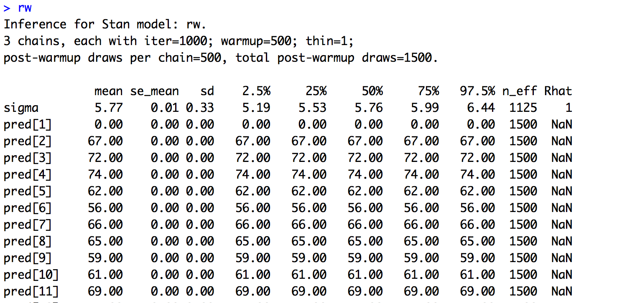
Model convergence?

Slide 17
Univariate state space models
State equation
Observation equation
Let’s compare models with and without the ar parameter phi in the process model

Slide 18
Using our stan_fit function
ss_ar = fit_stan(y = Temp, est_drift=FALSE, model_name = "ss_ar")
ss_rw = fit_stan(y = Temp, est_drift=FALSE, model_name = "ss_rw")

Slide 19
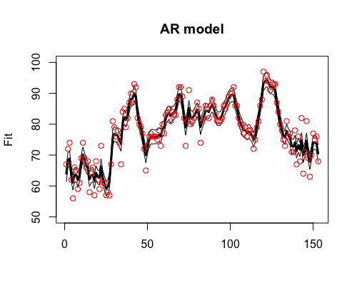
Estimates from AR SS model

Slide 20
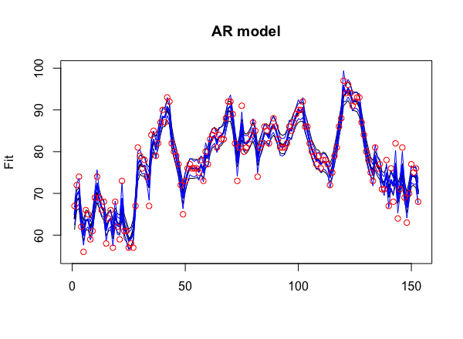
Estimates from both models

Slide 21
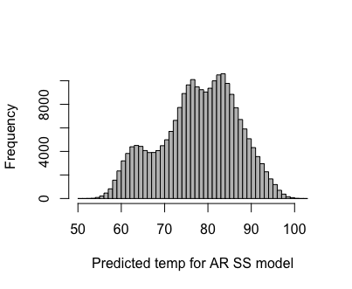
Posterior probability
What’s the probability that the temperature exceeds some threshold? 100 degrees?

Slide 22
Probability of > 100 degrees
pars = extract(ss_ar)
length(which(pars$pred > 100))
Low probability: ~ 20 / 229500

Slide 23
Dynamic Factor Analysis
Lake WA plankton example used in manual
# load the data (there are 3 datasets contained here)
data(lakeWAplankton)
# we want lakeWAplanktonTrans, which has been transformed
# so the 0s are replaced with NAs and the data z-scored
dat = lakeWAplanktonTrans
# use only the 10 years from 1980-1989
plankdat = dat[dat[,"Year"]>=1980 & dat[,"Year"]<1990,]
# create vector of phytoplankton group names
phytoplankton = c("Cryptomonas", "Diatoms", "Greens",
"Unicells", "Other.algae")
# get only the phytoplankton
dat.spp.1980 = plankdat[,phytoplankton]

Slide 24
Plankton data

Slide 25
Running the model
3 trend model to start
mod_3 = fit_dfa(y = t(dat.spp.1980), num_trends=3)

Slide 26
Trends need to be rotated (like MARSS)
Again we’ll use varimax rotation
Use function we’ve written, rotate_trends
rot = rotate_trends(mod_3)

Slide 27
names(rot)
Z_rot, rotated Z matrix for each MCMC draw
trends, rotated trends for each MCMC draw
Z_rot_mean, mean Z across draws
trends_mean, mean trends across draws
trends_lower, lower 2.5% on trends
trends_upper, upper 97.5% on trends

Slide 28
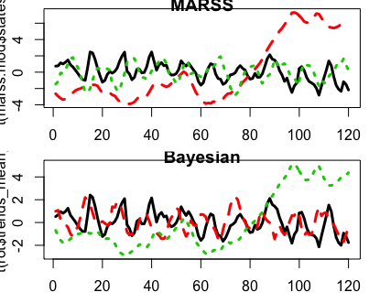
Predicted values from Bayesian DFA
Same results as MARSS (trends_mean)

Slide 29
Other variance structures
mod_3 = fit_dfa(y = t(dat.spp.1980), num_trends=3)
By default, this is modeling ‘diagonal and equal’
Diagonal and unequal or shared variances can also be specified using ‘varIndx’ argument
mod_3 = fit_dfa(y = t(dat.spp.1980), num_trends=3, varIndx = rep(1,5))

Slide 30
Model selection: how to select best number of trends?
First run multiple models with varying trends
mod_1 = fit_dfa(y = t(dat.spp.1980), num_trends=1)
mod_2 = fit_dfa(y = t(dat.spp.1980), num_trends=2)
mod_3 = fit_dfa(y = t(dat.spp.1980), num_trends=3)
mod_4 = fit_dfa(y = t(dat.spp.1980), num_trends=4)
mod_5 = fit_dfa(y = t(dat.spp.1980), num_trends=5)
3 minutes to fit all models (4000 iterations) – probably could be at least cut in half

Slide 31
Leave One Out Information Criterion (LOOIC)
Like AIC, lower is better
Simple function in library(loo)
loo(extract_log_lik(mod_1))$looic
Trends | LOOIC
1 | 1598.889
2 | 1535.885
3 | 1469.439
4 | 1455.7
5 | 1449.304

Slide 32
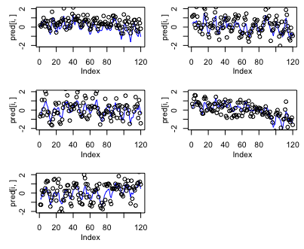
Predicted values
Also like MARSS, use $pred parameter

Slide 33
Uncertainty intervals on states
We often just present the trend estimates for DFA – but not uncertainty
Let’s look at effect of missing data on DFA for the harbor seal dataset
data("harborSealWA")

Slide 34
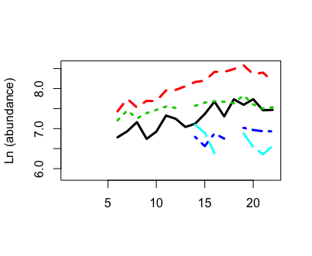
Assume single trend for the population

Slide 35
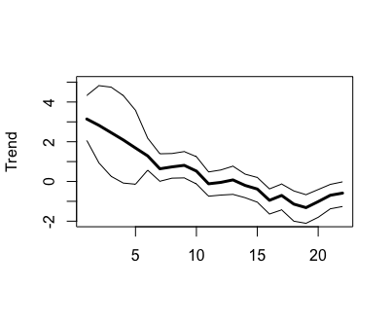
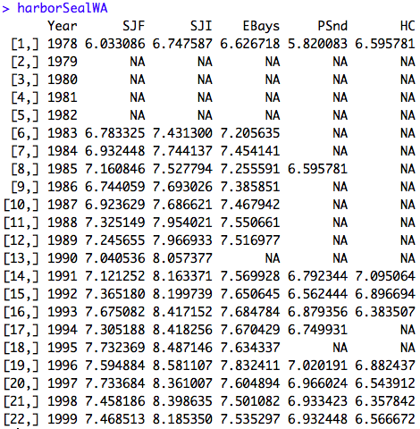
pars = extract(fit_dfa(y = t(harborSealWA[,-1]), num_trends = 1))

Slide 36
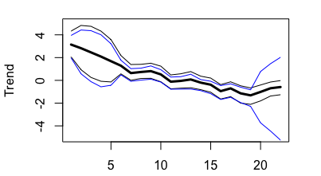
What happens when we delete last 3 years of data?

Slide 37
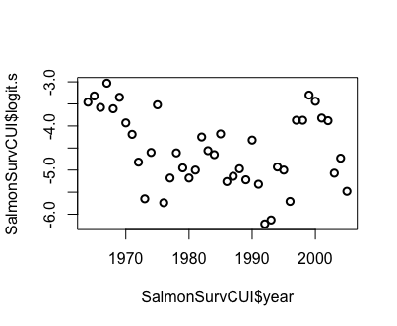
DLMs
Mark’s example of salmon survival
Logit transformed data

Slide 38
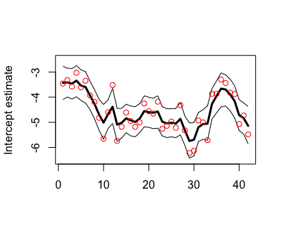
Fitting a DLM with time varying intercept
mod = fit_stan(y = SalmonSurvCUI$logit.s, model_name="dlm-intercept")

Slide 39
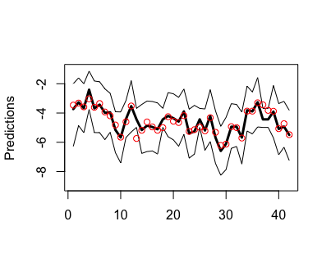
Constant intercept, time – varying slope
mod = fit_stan(y = SalmonSurvCUI$logit.s, x = SalmonSurvCUI$CUI.apr, model_name="dlm-slope")
Wider CIs than
time varying intercept
model

Slide 40
Time varying intercept and slope
Use model.matrix() to specify ‘x’
x = model.matrix(lm(SalmonSurvCUI$logit.s ~ SalmonSurvCUI$CUI.apr))
mod = fit_stan(y = SalmonSurvCUI$logit.s, x = model.matrix(lm(SalmonSurvCUI$logit.s ~ SalmonSurvCUI$CUI.apr)), model_name="dlm")

Slide 41
Summary
Additional models available, e.g. 'marss'
Very flexible
Easy to add custom features on existing code

